Slide 1
AlphaGo
Sungjoon Choi
(sungjoon.choi@cpslab.snu.ac.kr)
David Silver, et al. "Mastering the game of Go with deep neural networks and tree search." Nature 529.7587 (2016): 484-489.

Slide 2
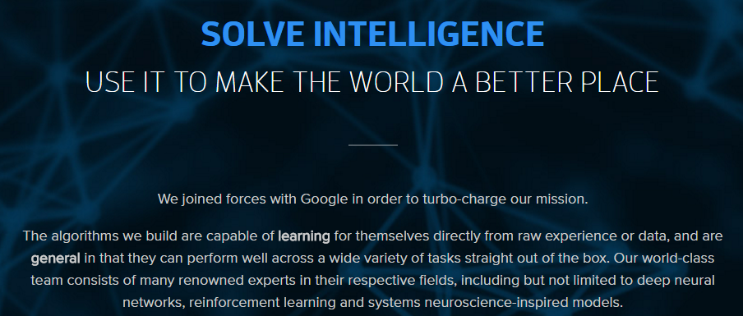
DeepMind

Slide 3
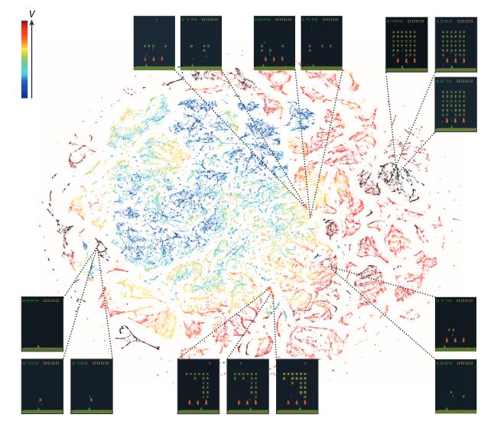
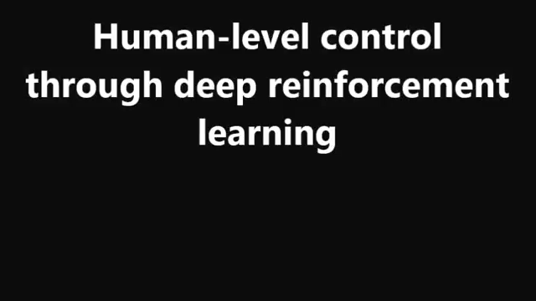
Prior Work of DeepMind
V. Mnih, K. Kavukcuoglu, D. Silver, A. A. Rusu, J. Veness, M. G. Bellemare, and S. Petersen (2015). Human-level control through deep reinforcement learning. Nature, 518(7540), 529-533.

Slide 4
Contents
Complexity of Go
Monte-Carlo Tree Search
Training Networks
Searching with policy and value networks
Experiments

Slide 5
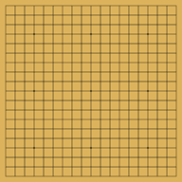
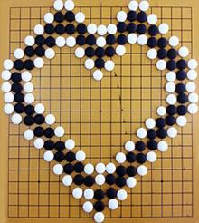
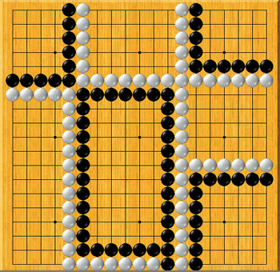
Complexity of Go

Slide 6
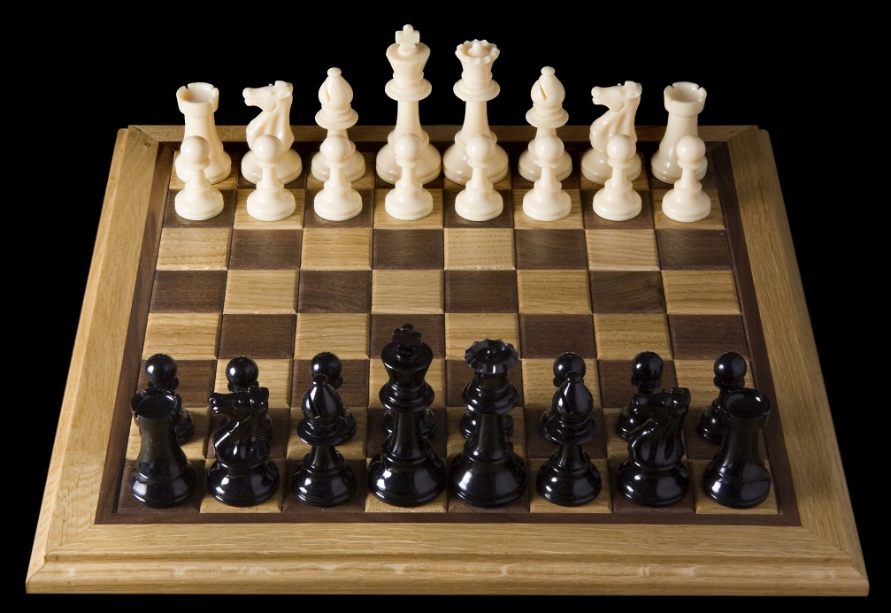
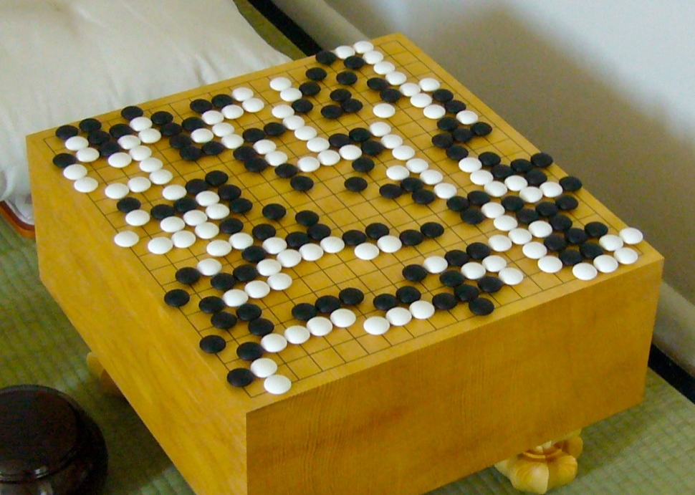
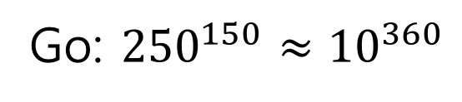
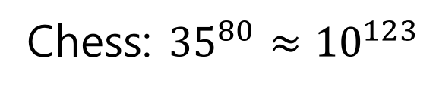
Complexity of Go
Chess: ${35}^{80}≈{10}^{123}$
Go: ${250}^{150}≈{10}^{360}$

Slide 7
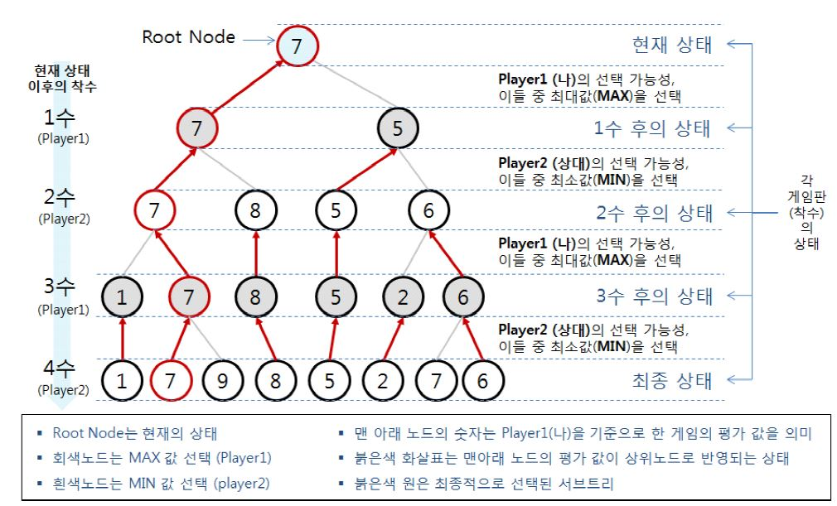
Monte-Carlo Tree Search

Slide 8
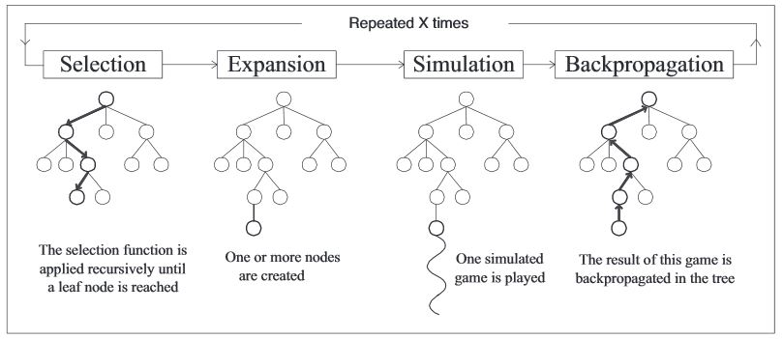
Monte-Carlo Tree Search
By some selection rule
By some expansion rule
By some simulation method

Slide 9
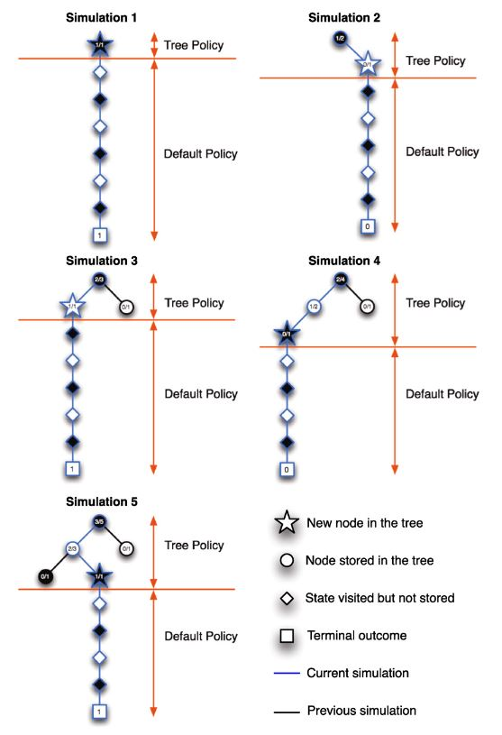
MCTS Example

Slide 10
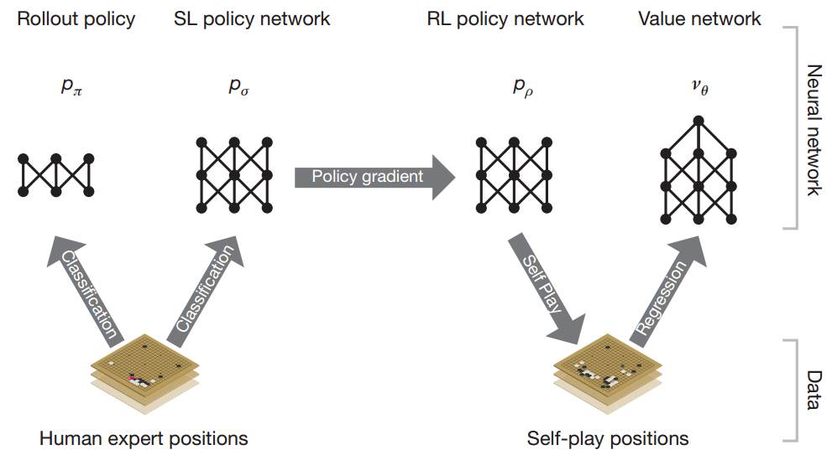
MCTS in AlphaGo

Slide 11
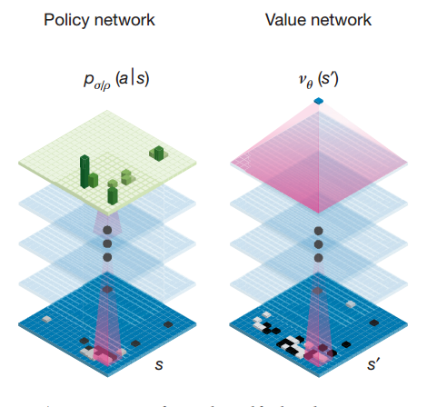
Policy Net & Value Net

Slide 12
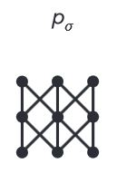
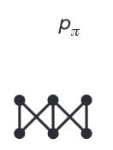
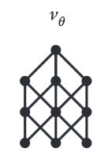
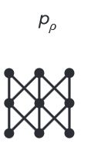
MCTS in AlphaGo
Rollout net
Value net
SL Policy Network
RL net

Slide 13
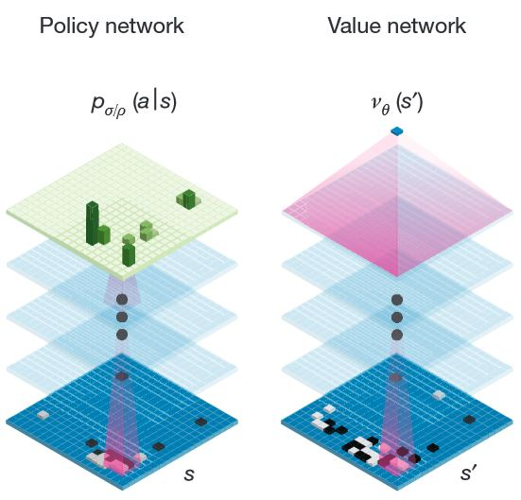
Training
Rollout Policy Network (Rollout net)
Supervised Learning Policy Network (SL net)
Reinforcement Learning Policy Network (RL net)
Value Network (Value net)
SoftMax (13)
Tanh, Fc (15)
ReLU, Fc (14)
3*3, 192 filter
stride 1, ReLU
(2 ~ 12)
No Info (12,13)
3*3, 192 filter
stride 1, ReLU
(2~11)
5*5, 192 filter
stride 1, ReLU(1)
5*5, 192 filter
stride 1, ReLU(1)

Slide 14
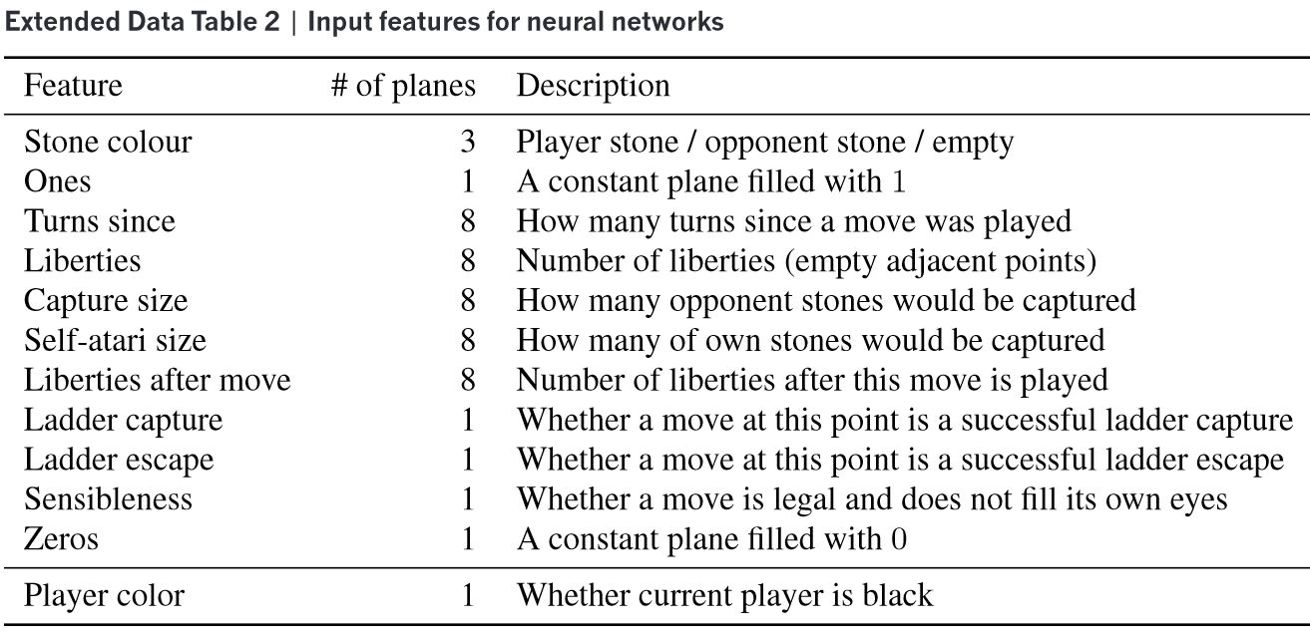
Training

Slide 15
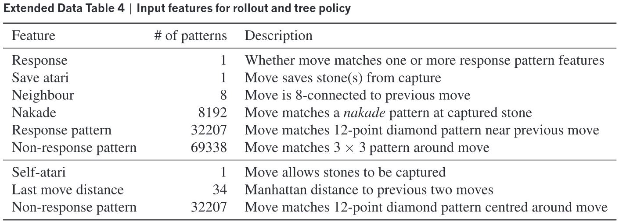
Training

Slide 16
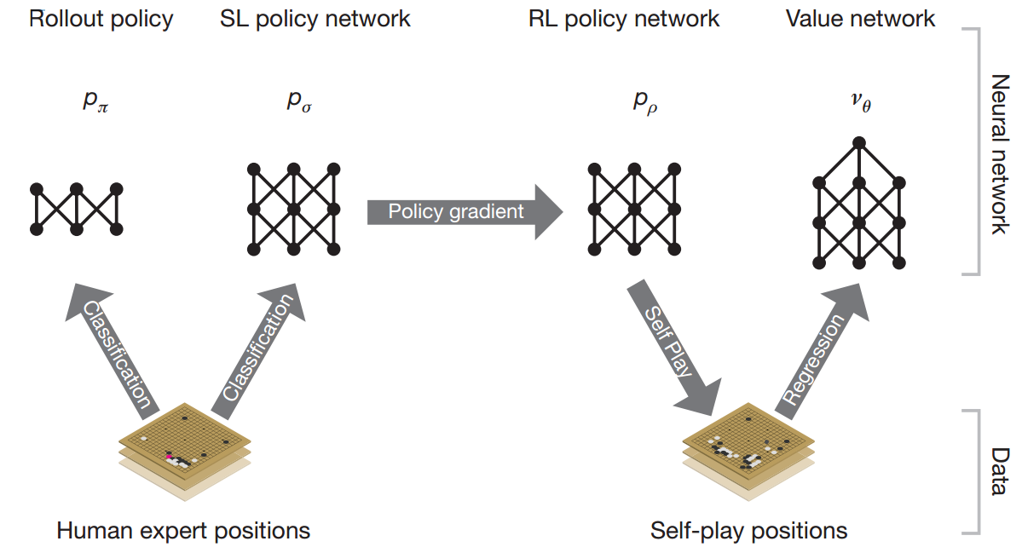
Training

Slide 17
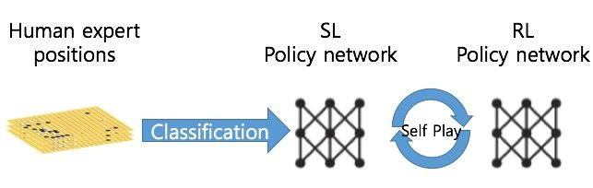
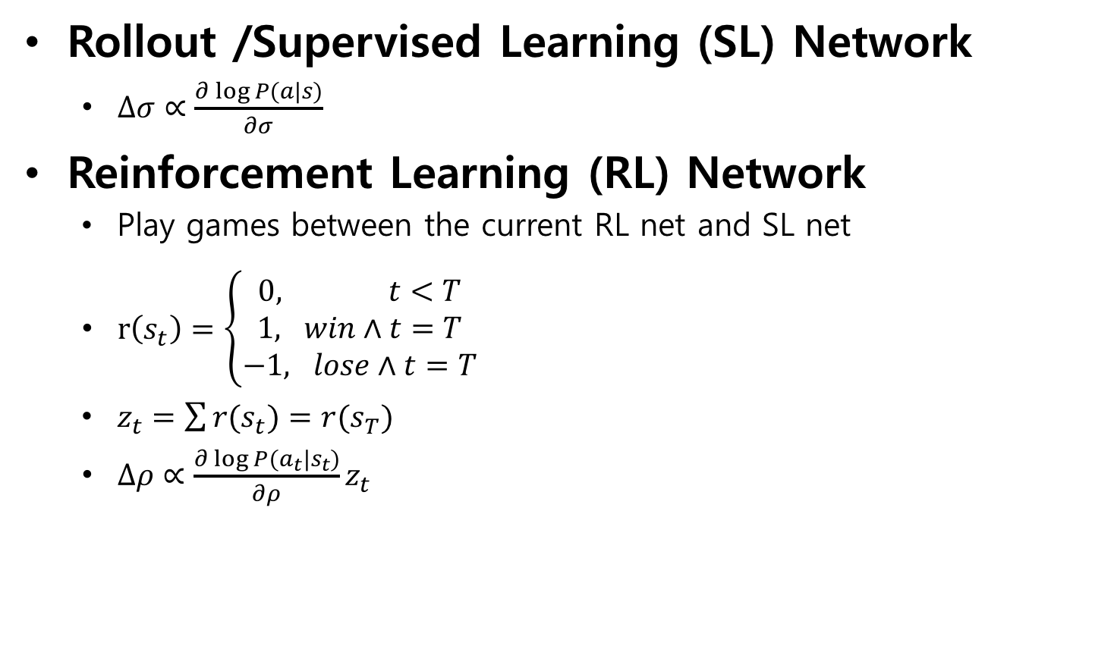
Training policy nets
Rollout /Supervised Learning (SL) Network
$∆σ∝\frac{∂\log{P(a|s)}}{∂σ}$
Reinforcement Learning (RL) Network
Play games between the current RL net and SL net
$r\left(s_{t}\right)=\left\{\begin{aligned}0, t<T \\ 1, win∧t=T \\ &−1, lose∧t=T\end{aligned}\right.$
$z_{t}=\sum{r(s_{t})}=r(s_{T})$
$∆ρ∝\frac{∂\log{P(a_{t}|s_{t})}}{∂ρ}z_{t}$

Slide 18
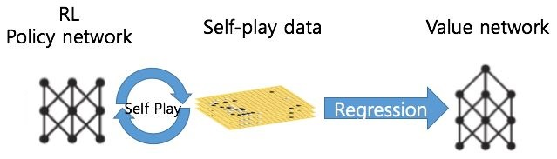
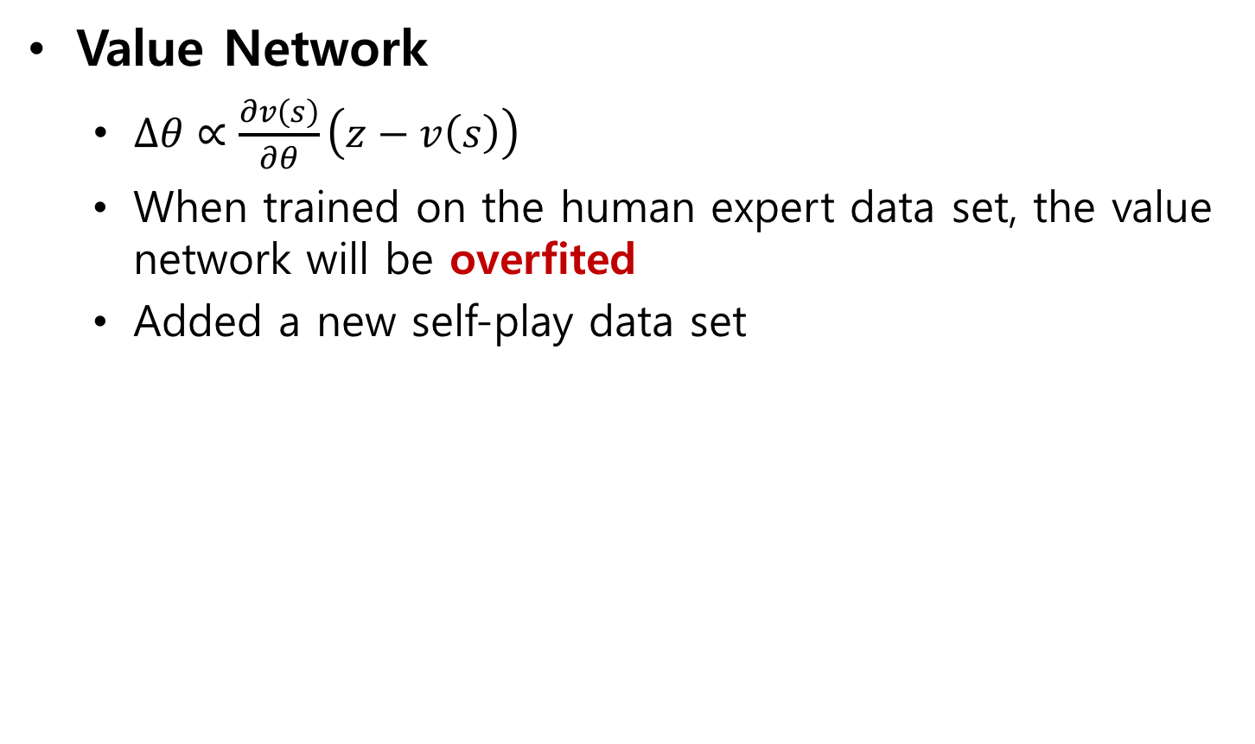
Training value nets
Value Network
$∆θ∝\frac{∂v\left(s\right)}{∂θ}\left(z−v\left(s\right)\right)$
When trained on the human expert data set, the value network will be overfited
Added a new self-play data set

Slide 19
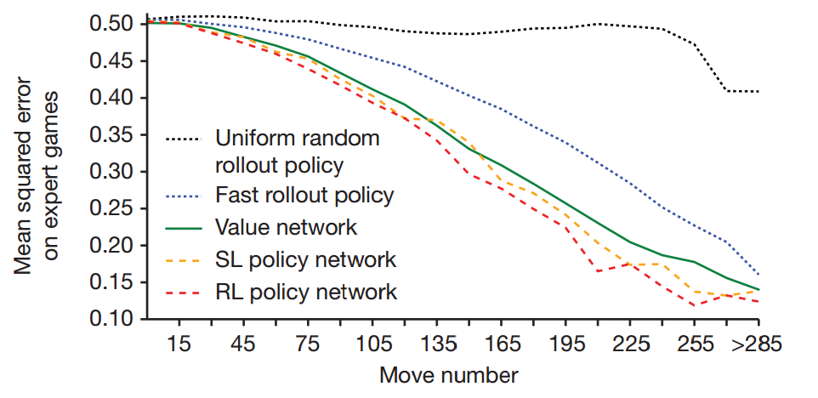
Game result prediction

Slide 20
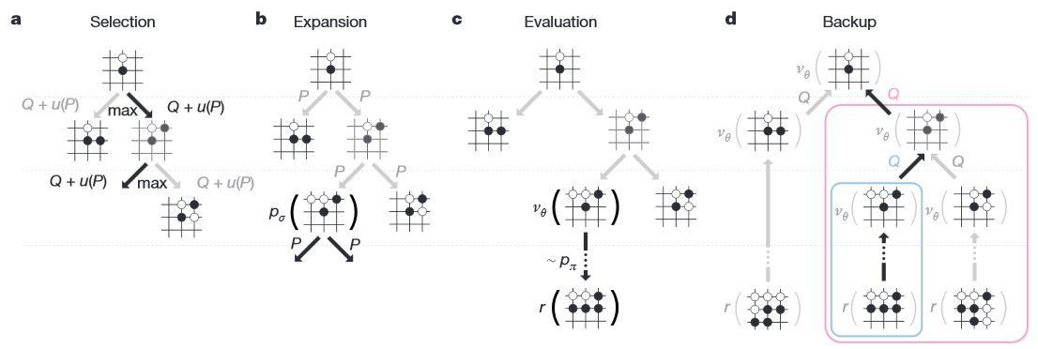
Execution phase

Slide 21
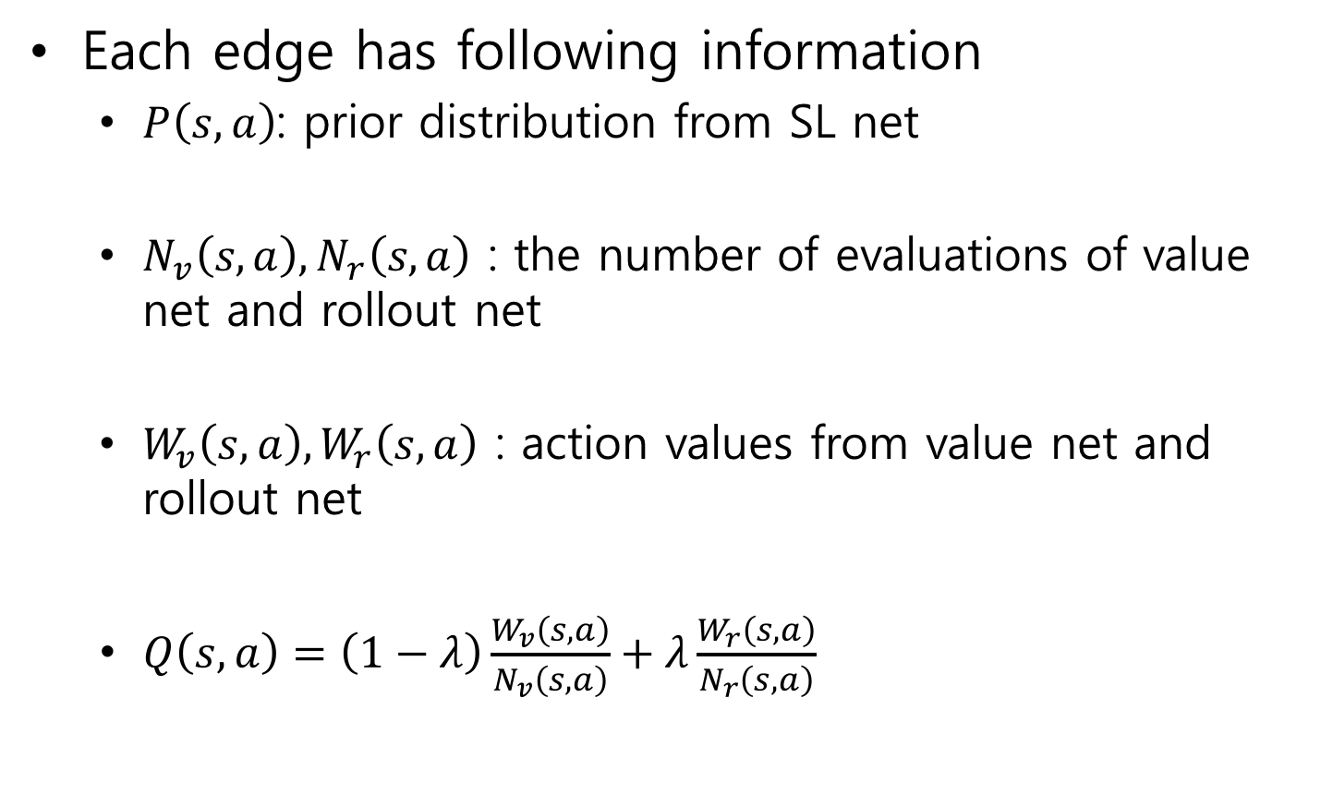
Execution phase
Each edge has following information
$P\left(s,a\right)$: prior distribution from SL net
$N_{v}\left(s,a\right),N_{r}\left(s,a\right)$ : the number of evaluations of value net and rollout net
$W_{v}\left(s,a\right),W_{r}\left(s,a\right)$ : action values from value net and rollout net
$Q\left(s,a\right)=\left(1−λ\right)\frac{W_{v}\left(s,a\right)}{N_{v}\left(s,a\right)}+λ\frac{W_{r}\left(s,a\right)}{N_{r}\left(s,a\right)}$

Slide 22
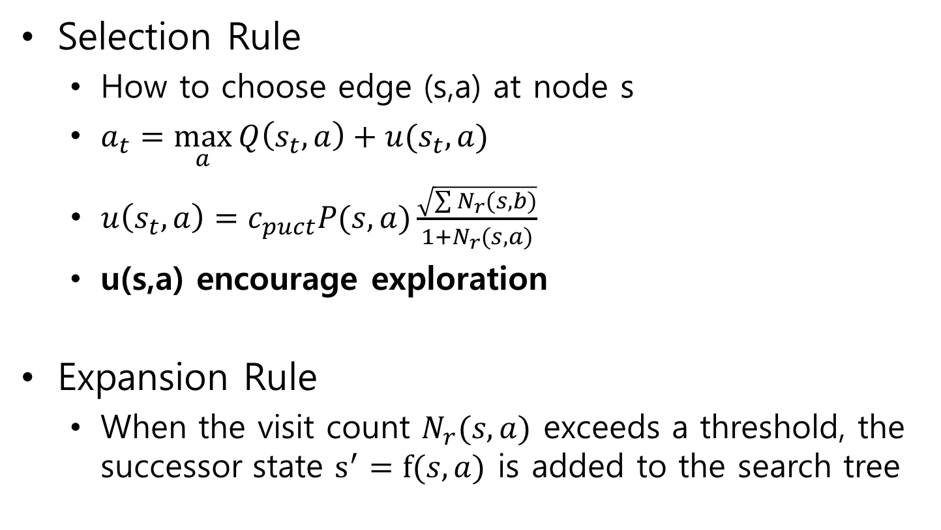
Execution phase
Selection Rule
How to choose edge (s,a) at node s
$a_{t}=\max_{a}{Q\left(s_{t},a\right)}+u(s_{t},a)$
$u\left(s_{t},a\right)=c_{puct}P(s,a)\frac{\sqrt{\sum{N_{r}(s,b)}}}{1+N_{r}(s,a)}$
u(s,a) encourage exploration
Expansion Rule
When the visit count $N_{r}(s,a)$ exceeds a threshold, the successor state $s^{′}=f(s,a)$ is added to the search tree

Slide 23
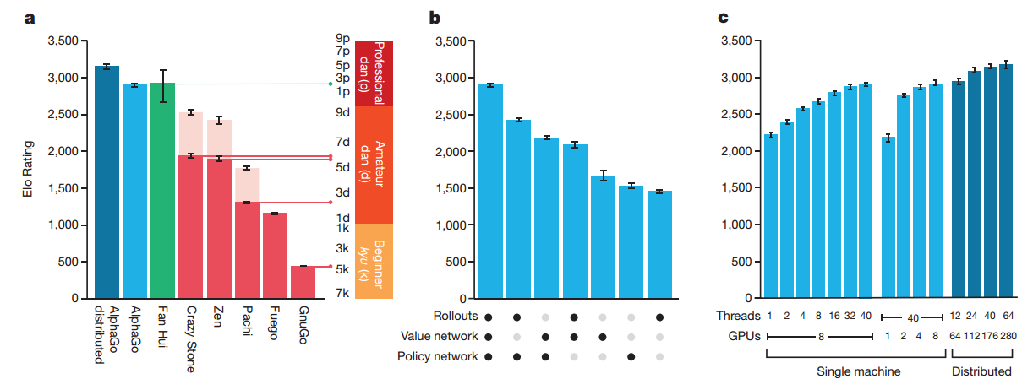
Result
Evaluation of playing strength of AlphaGo
Single-machine AlphaGo: 99.8%
With four handicap stones: 77%, 86% and 99% (vs CrazyStone, Zen and Pachi)
Distributed AlphaGo: 77% (vs Single-machine), 100% (vs Others)

Slide 24
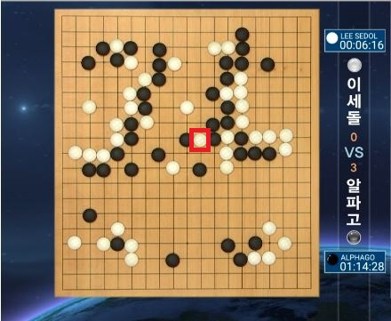
Result
Match score: AlphaGo 4 - Lee Sedol 1

Slide 25

Conclusion

